Slide 1
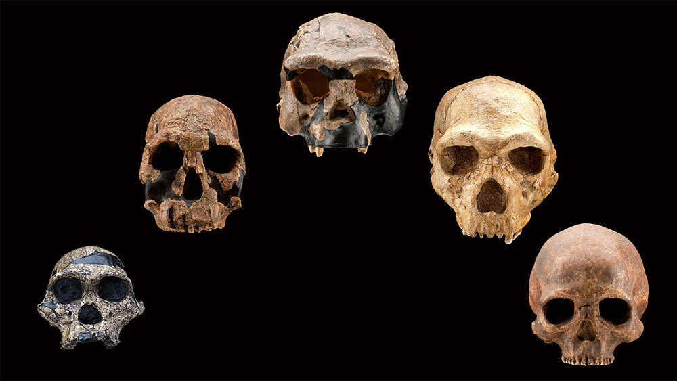
HUMAN SPECIATION
Michelle Pretorius
Notes:
The origin of species and the study of speciation has always generated great enthusiasm, both within the scientific community as well as the general public.
However, even with growing interest in the subject, there is still a basic lack of agreement on the fundamental mechanisms driving the evolution of new species, and how these entities should be organized.
This debate has even infiltrated the study of human evolution.
Most paleoanthropologists currently recognize some 15 to 20 different species of early humans, however there are various controversies surrounding hominin taxonomy and systematics.
For example, how many taxa are represented in the hominin clade?

Slide 2
Process-based Species Concepts
1
Biological Species Concept
Evolutionary Species Concept
Recognition Species Concept
Reproductive Isolation
Temporal BSC
Interbreeding
Notes:
To understand speciation, you must first define what a species is – and this is achieved through species concepts
The most widely used species concepts are those that are process based
The BSC suggests that species are ‘groups of interbreeding natural populations reproductively isolated from other such groups’
However, one issue with this concept is that a reference has to be made to at least one other species.
It also stresses mechanisms for maintaining genetic isolation, rather than emphasizing the features that conspecific individuals have in common.
Therefore, this theory can often not be applied to analyzing human fossils, especially those that lack comparable fossils.
The ESC originated as an attempt to add a temporal dimension to the BSC.
According this concept a species is ‘an ancestral–descendant sequence of populations evolving separately from others and with its own evolutionary role and tendencies’
The boundaries of these segments can be discontinuities in the fossil record, and are often interpreted as representing cladogenic events.
Finally, the RSC focusses more on the processes that promote interbreeding, i.e. a species is ‘the most inclusive population of individual, biparental organisms which shares a common fertilization system’
BUT It is difficult enough to apply process-related species definitions to living taxa, let alone to the fossil record. Therefore, most paleoanthropologists apply species concepts that are more pattern-related.

Slide 3
Method-based Species Concepts
1
Phenetic Species Concept
Phylogenetic Species Concept
Monophyletic Species Concept
Mammary Glands
Mammary Glands
Species 1
Species 2
Autapomorphic
Traits
Non-
mammalian
Egg laying mammals
Marsupials
Placental
Mammals
Species 3
Notes:
Here, each concept focuses on a specific aspect of a specimens phenotype.
The PeSC gives equal weight to all aspects of the phenotype
multivariate analysis is used to detect clusters of individual specimens that share the same, or similar, character expressions
the PySC emphasizes the unique suite of symplesiomorphic and synapomorphic characters that defines each species
and thus is ‘the smallest aggregation of populations diagnosable by a unique combination of character states.’
Finally, the MSC, under which the scope of the morphological evidence is narrower still, for under the MSC definition species are defined according to autapomorphic characters or specifically derived traits a species possesses.
However, the MSC is the product of circular reasoning, as it assumes the observer knows which characters are autapomorphic, but in order to understand this one must apply cladistics theory, with would then require a species concept and so on.

Slide 4
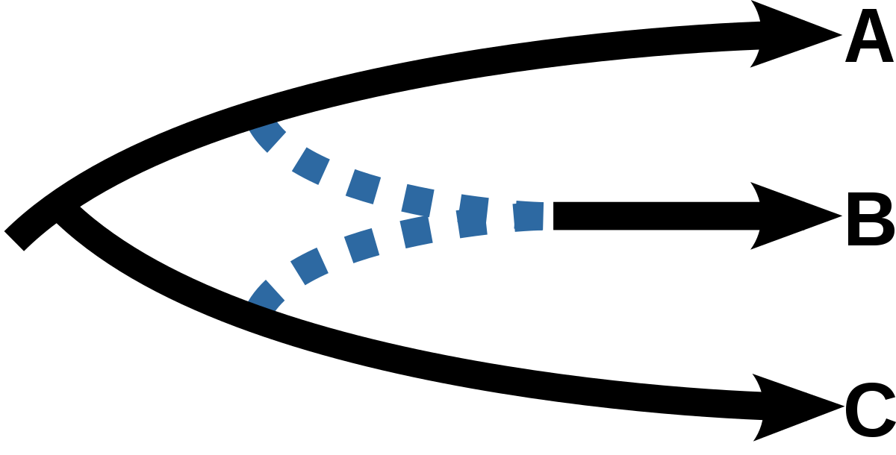
Reticulate Evolution
1
Notes:
The species concepts considered thus far are all based on a ‘bifurcating hierarchical’ model → where one species splits into two (or more) species
Which then may or may not become extinct
In this new species arise in geographically isolated subpopulations by a process called allopatric speciation.
However, Speciation is interpreted very differently in so-called reticulate evolution.
This interprets speciation as a process whereby a new species can form by the hybridization of two existing species.
This model of evolution is close to how some researchers interpret evolution in geographically widespread groups like baboons, and thus many newer generations of paleoanthropologists are trying to adapt this concept when analysing human evolution.

Slide 5
2
A
B
a
b
c
d
e
Lumpers
Splitters
Notes:
FINALLY, even when applying a single species concept, variations in species number can still arise do to differing evolutionary models used to interpret the fossil record.
For example, if a punctuated equilibrium model of evolution is adopted along with a branching, or cladogenetic, interpretation of the fossil record,
then researchers will tend to divide the hominin fossil record into a larger rather a smaller number of species, and are often referred to as “LUMPERS”.
Conversely, researchers who favour a phyletic gradualism model that emphasizes morphological continuity instead of discontinuity
see species as longer lived and more prone to substantial changes in morphology through time
will divide the hominin fossil record into fewer, more inclusive, species, and is often referred to as SPLITTERS.

Slide 6
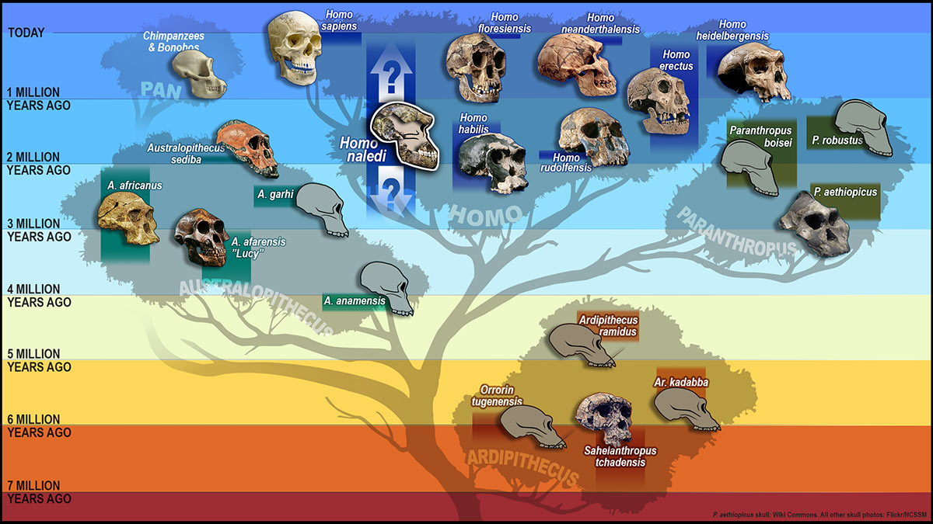
Kenyanthropus platyops
Notes:
The diagram is based on the Pylogenetic SC which, as mentioned, emphasizes the unique suite of
symplesiomorphic (ancestral traits shared by taxa)
and synapomorphic (shared derived character or trait state that distinguishes a clade from other organisms)
Use foot morphology to infer bipedalism, skull size to infer brain size and skull crests and teeth to infer diet all of which can help place the fossil on the human evolution time line.
All the species shown would be present under splitting methods

Slide 7
Kenyanthropus platyops
Notes:
However, if one was a lumper then only the species in red would be recognized
However, for the purpose of this presentation I am going to be a splitter and look at the speciose diagram

Slide 8
Kenyanthropus platyops
Notes:
Clades which is a group generally evolved from a common ancestor are generally applied when dealing with process based SC
However, when using method based SC grades are more commonly used and is based on assessing the outcome of evolutionary history.
Taxa in the same grade:
eat the same sorts of foods and
share the same posture and
mode(s) of locomotion
The judgment about how different two diets or two locomotor strategies have to be before the taxa concerned are considered to belong to different grades is still a subjective one,
but until we can be sure we are generating reliable hypotheses about the relationships among hominin taxa the grade concept helps sort taxa into broad functional categories
These include:
“Anatomically modern Homo”,
“Premodern Homo”,
“Transitional hominins” and or “Archaic hominins”,
“Megadont archaic hominins”
“Possible hominins”.
For the purpose of time, I am only going to go through a single species discovered in the last 30 years within these grades

Slide 9
Kenyanthropus platyops
Possible hominins
Notes:
Possible Hominins
However, there has been various disagreements over the true classification of this clade in relation to homoplasy.
Homoplasy is when shared characters are not inherited directly from a common ancestor but instead evolved separately.
specimens appear more related than they really are.
Very few human taxonomy researcher take into account that the cranial and/or dental features they assume to be diagnostic of a human may in fact be homoplasies.
Entire grade as been discovered in the last 30 years

Slide 10
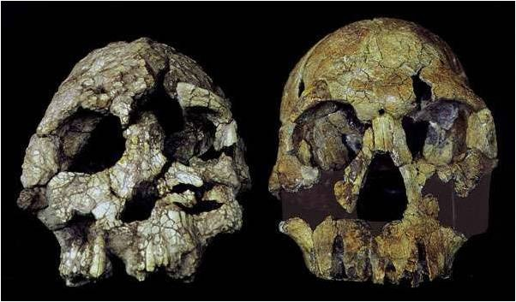
Kenyanthropus platyops
Possible hominins
Notes:
Orrorin tugenensis (Senut et al. 2001), recovered in 2000 from Kenya.
morphology of three femoral fragments collected has been interpreted as suggesting that O. tugenensis is an obligate biped
However, various radiographs and CT scans of the femoral neck has indicated that this species may have utilized a mix of bipedal and non-bipedal locomotion
In addition, the postcranial bones of O. tugenensis have been shown to be 1.5 times larger than those of the more modern Au. afarensis, yet its post-canines were found to be significantly smaller and thus more similar to those of extant humans.
Due to its novel combination of ape and human traits, O. tugenensis was, and still is, classified as a separate genus.

Slide 11
Kenyanthropus platyops
Archaic Hominins

Slide 12
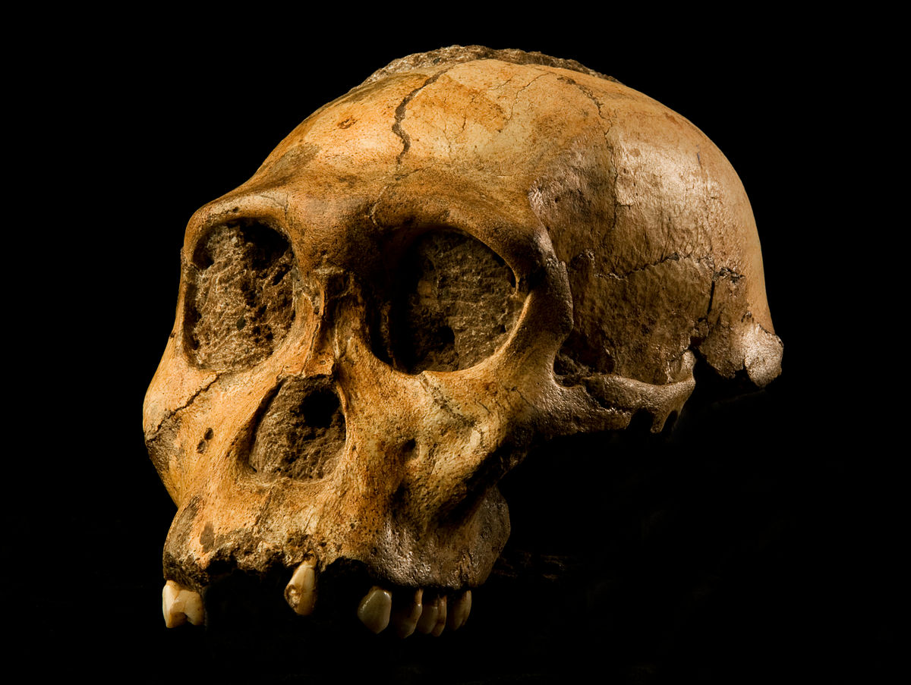
Archaic Hominins
Notes:
The most recently recognized taxon in this grade is Australopithecus sediba
Au. sediba’s mixture of primitive traits (small size, long arms and small cranial capacity), place it other australopithecines
With derived traits also found in Homo made Au. sediba an interesting find and thus placed closer to homo grade
Au. sediba also bears a strong resemblance to Au. africanus, another South African fossil species, in both cranial and dental structures.
However, the species differ in exact the shape of the cranium and the face, suggesting that Au. sediba was more derived compared to Au. Africanus,
This led the original researchers to conclude that Au. sediba was descended from Au. Africanus, and ancestral, or closely related to the ancestor, to the genus Homo.
This placement of this species has been greatly contested with some questioning whether cranial and dental features are most important in defining Homo, since some fossils, such as the Au. sediba remains, contain a combination of features.

Slide 13
Kenyanthropus platyops
Megadont Archaic Hominins
Notes:
This grade includes hominin taxa conventionally included in the genus Paranthropus and one Australopithecus species, Australopithecus garhi.
The term megadontia refers to both the absolute size of their teeth
In fact, up until the last half-decade, the majority of the scientific community included all the species of both Australopithecus and Paranthropus in a single genus.
The emergence of the Paranthropus could be either a display of divergent or convergent evolution.

Slide 14
Kenyanthropus platyops
Megadont Archaic Hominins
Notes:
The most recent addition to the megadont archaic hominin grade is Australopithecus garhi
The specimen combines a primitive cranium with large-crowned post-canine teeth therefore grouped with the megadont,
however, unlike the other megadonts, the incisors and canines lacks the enamel thickness and thus was grouped with the australapithacines

Slide 15
Premodern Homo
Kenyanthropus platyops
Notes:
This grade grouping includes Pleistocene Homo taxa that lack the derived and distinctive size and shape of the modern human cranium and postcranial skeleton.
Some individuals in these taxa possessed only medium-sized brains, yet they exhibit modern human-like body proportions.

Slide 16
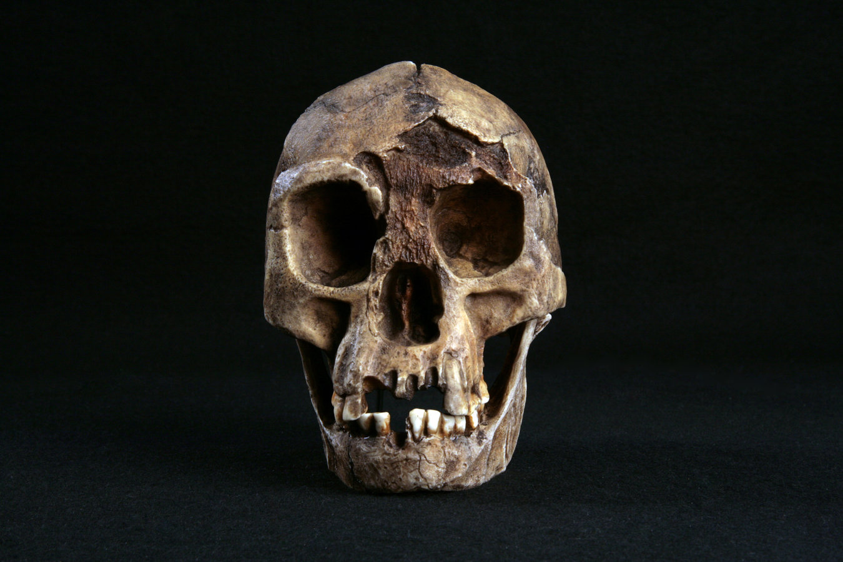
Premodern Homo
Kenyanthropus platyops
Notes:
Discovered in 2004 and added to the genus Homo was H. floresiensis
It is only known from Liang Bua, a cave in Indonesia
This hominin displays a unique combination of early Homo-like cranial and dental morphology,
a previously unknown suite of pelvic and femoral features and
small stature (1 m).
When it was first described researchers interpreted it as a H. erectus that had undergone endemic dwarfing,
but more recently researchers have suggested it could be a dwarfed Homo habilis-like transitional grade taxon

Slide 17
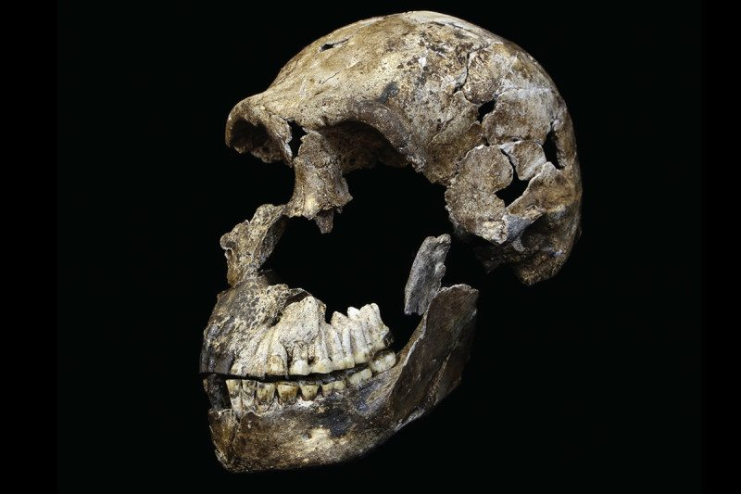
Premodern Homo
Kenyanthropus platyops
Notes:
Finally, The most recent fossil discovered to date is that of Homo naledi.
The skeletal anatomy displayed both plesiomorphic features found in the australopithecines as well a more apomorphic traits of the genus Homo.
An example of this is its hip mechanics, where the flared shape of the pelvis are similar to that of australopithecines, whereas the structuring of the legs, feet and ankles were more similar to that of the genus Homo.
H. naledi skeletons reflect the complexity of evolution, indicating that the origins of the genus Homo may be POLYPHYLETIC and evolved separately in different parts of Africa.
Some researchers agree the H. naledi remains represent a new species, but suggest they might represent the evolution of an isolated population within South Africa, similar to that of Homo floresiensis, another relict population from the island of Flores in Indonesia

Slide 18
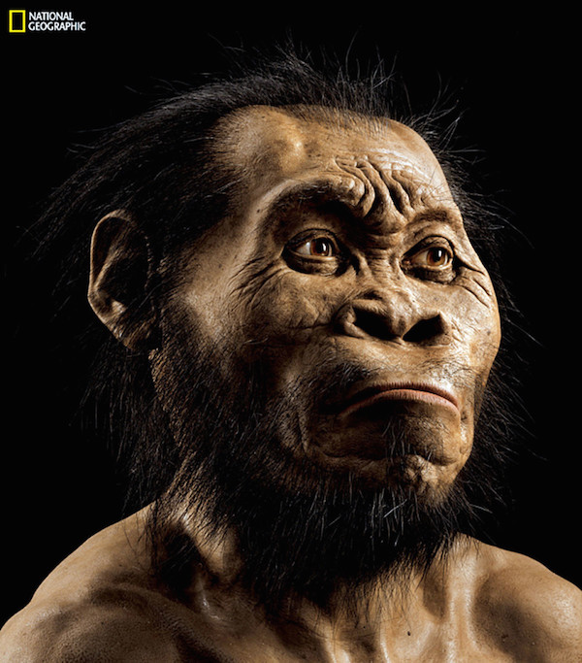
Notes:
The study of evolution as come a long way in recent past, and with new technical advances in s CT and microCT scans our understanding on the origin of the human species can only improve
Thank you

